Slide 1
Examining
Development Over Time
Gapminder and Economic Issues

Slide 2
Game time!!!
Find a group of three–four
Get a set of cards.
Organize the cards according to development (i.e., least developed to most developed country).
Prepare to explain your choices to the class.

Slide 3
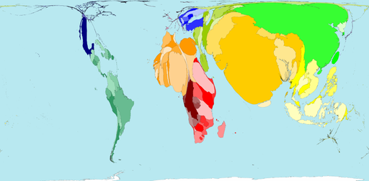
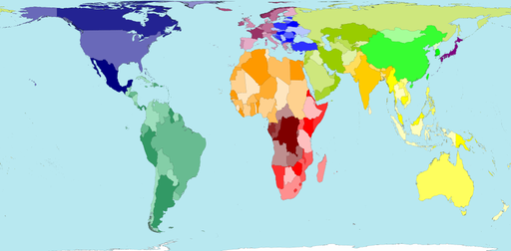
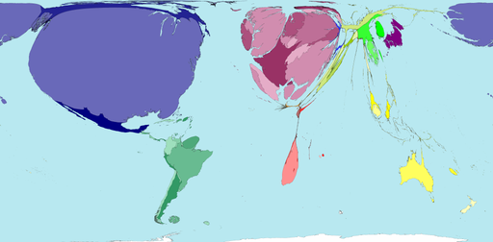
How much does
the world make?
Population living on less than $10 a day
Map of the world
Population living on more than $200 a day

Slide 4
Game time part 2!!!
What were the measures the class used to evaluate development?
What other measures can we consider?
Get a copy of the “Gapminder World Map” graph.
On the graph each bubble is a country. The size of the bubble relates to the population of the country and the colour to the region of the world. The y-axis is life expectancy and the x-axis is income per person.
Find the countries you ranked on the graph.
How does it compare to the placement your group decided on?
Were there any surprising results?
Could this graph be used to divide the countries of the world into different categories? Why or why not?

Slide 5
Gapminder
This graph shows how long people live and how much money they earn. Let’s see how countries have developed since 1800… http://www.gapminder.org/world/#;example=75;
What does the graph show? As you watch take note of any five things that interest you or that you noticed about the animation.

Slide 6
What this graph shows:
In 1800, income per person was low and life expectancy was very short in all countries.
Health is better everywhere today, even in the poorest countries.
Income is much higher in most, but not all, countries today.
The income and health gaps between countries are larger today.
Most people today live in “middle income” countries

Slide 7
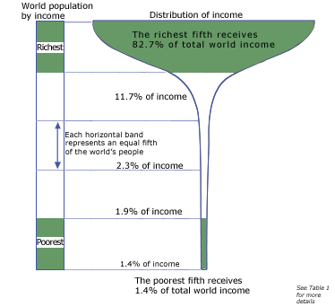
World’s population arranged by income. Each horizontal band represents and equal fifth of the world’s people
The richest fifth receives 82.7% of total world income and the poorest received 1.4% of the world’s income.
Source: UNDP, Human Development Report 1992 (New York: Oxford University Press, 1992.

Slide 8
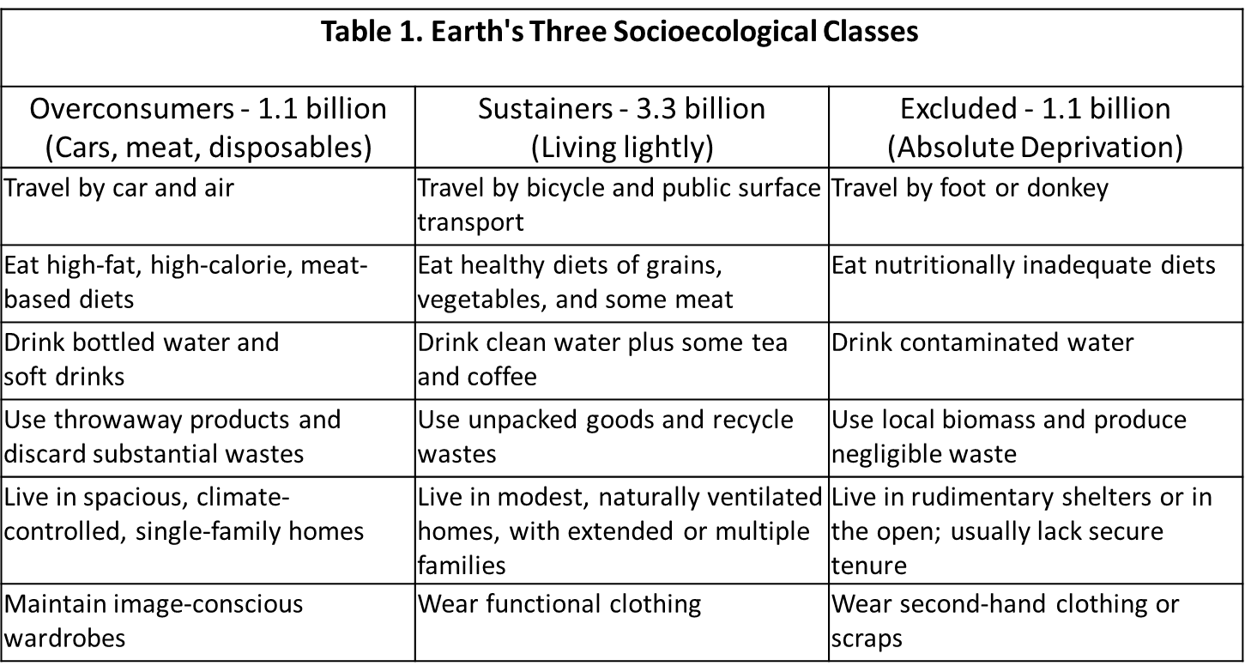
While this is one interpretation of the lifestyle in the varying divisions of wealth, do you feel it is accurate? Where do you see yourself?
Source: UNDP, Human Development Report 1992 (New York: Oxford University Press, 1992.

Slide 9
Another cool set of diagrams…
Let’s look at how the world shares its money… www.gapminder.org/downloads/human-development-trends-2005/

Slide 10
Your task:
In the same groups brainstorm at least 10 reasons as to why the developing world has not achieved economic parity with the developed world. In other words, why are we affluent and they are not?
How does income disparity influence the ability of the globe to be sustainable?

Slide 11
Reasons for economic
disparity in the world
Undemocratic local government
Poor infrastructure
Lack of health care
War
Racism
Oppression
Disease/epidemics
Sexual status/sexual orientation rights
Greed
Population
Hunger
Education
Debt/deficit
Multinationals/transnational
Trade sanctions
Environmental reasons
Traditional values (class divisions)
Overshot carrying capacity
Lack of exports
Cash crops
Civil strife
Ignorance
Poor trade policies
Egocentrism
Historical reasons
Other?

Slide 12
More Gapminder world
Select Norway, Venezuela and Canada and watch their progress over time.
Considering what you have learned about each country note any specific changes and patterns over time? (Think points of historical challenge or opportunity)

Slide 13
Final thoughts…
Through the PowerPoint you were introduced to different graphics that attempted to demonstrate how the regions of the world have changed since the 1800s.
How is modelling relevant when analyzing the development of a nation?
How could these tools be used to develop the world towards sustainability? Think people, profit and planet.

