Slide 1
Beyond GDP:
New Measures of Progress and Sustainability

Slide 2
What are the things you value most in life?
Have students think back to yesterday`s scenario and discuss the following:
What were the things you missed most?
Use this thought to help you to list “What you value most in life?” Take a couple of minutes and make a list of the things you value most in your life.
Once you have made a list, for each item give it a dollar value.
What are these things worth to you?
How easy or difficult was it to put a price on these things?

Slide 3
Development indicators
As you learn about the following development indicators, consider the following questions:
What methods do you know of that are used to measure development around the world? What about sustainability?
Which indicator values the items you values the most?
Which indicator values sustainability as an indicator of development?
How do you think development and sustainability are linked?

Slide 4
Gross Domestic Product (GDP)
The total market value of all final goods and services produced in a country in a given year.
Equal to: total consumer, investment and government spending, plus the value of exports, minus the value of imports.
Most typical measure of the development of a country.
PPP
A theory which states that the exchange rate between one currency and another is in equilibrium when their domestic purchasing powers at that rate of exchange are equivalent.
In short, what this means is that a bundle of goods should cost the same in Canada and the United States once you take the exchange rate into account.
Common calculation used to balance global GDPs
Video: Going Beyond GDP by European Commission

Slide 5
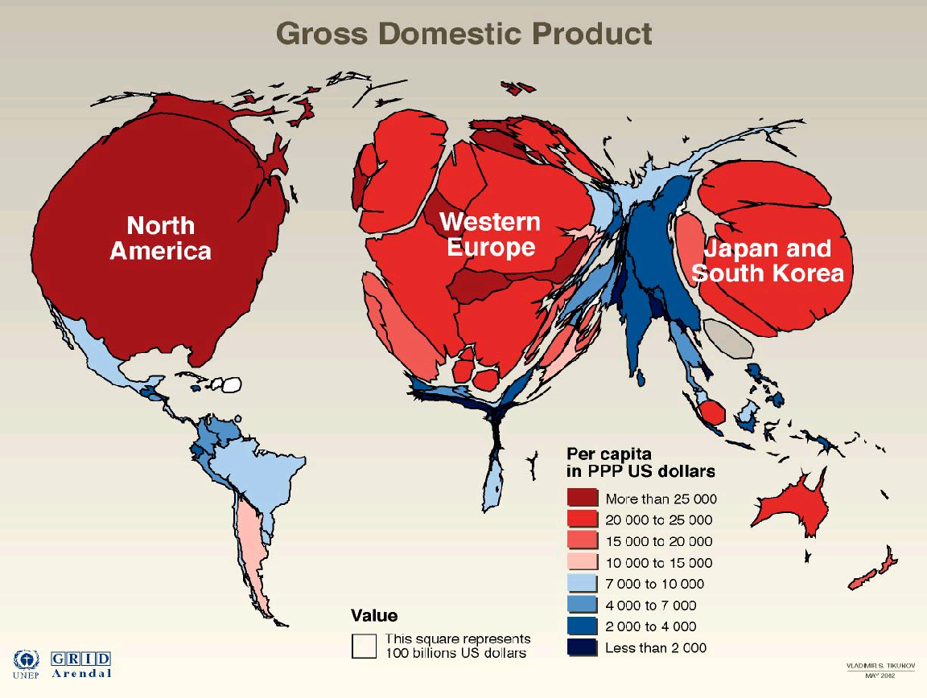

Slide 6
What’s wrong with GDP?
"TOO MUCH AND TOO LONG, we seem to have surrendered community excellence and community values in the mere accumulation of material things. Our gross national product ... if we should judge America by that -counts air pollution and cigarette advertising, and ambulances to clear our highways of carnage. It counts special locks for our doors and the jails for those who break them. It counts the destruction of our redwoods and the loss of our natural wonder in chaotic sprawl. It counts napalm and the cost of a nuclear warhead, and armored cars for police who fight riots in our streets. It counts Whitman's rifle and Speck's knife, and the television programs which glorify violence in order to sell toys to our children.

Slide 7
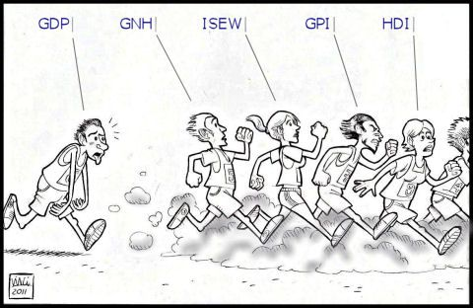
What’s wrong with GDP?
Yet the gross national product does not allow for the health of our children, the quality of their education, or the joy of their play. It does not include the beauty of our poetry or the strength of our marriages; the intelligence of our public debate or the integrity of our public officials. It measures neither our wit nor our courage; neither our wisdom nor our learning; neither our compassion nor our devotion to our country· it measures everything, in short, except that which makes life worthwhile. And it tells us everything about America except why we are proud that we are Americans."
Robert F. Kennedy Address, University of Kansas, Lawrence, Kansas, March 18, 1968
Source: llustration by Vincenzo Cardona Albini

Slide 8
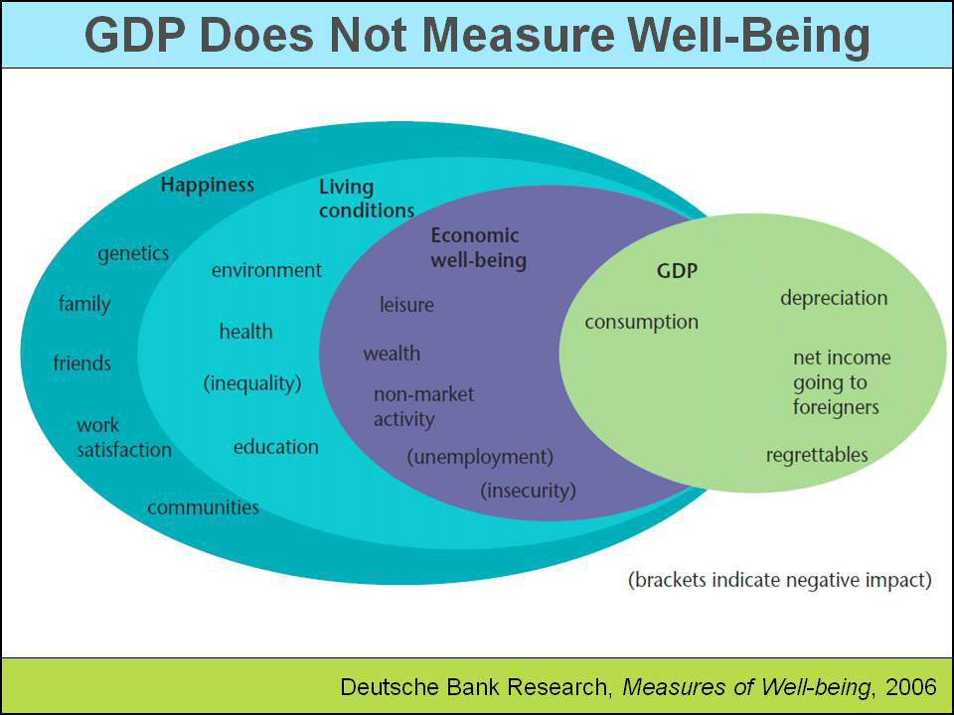
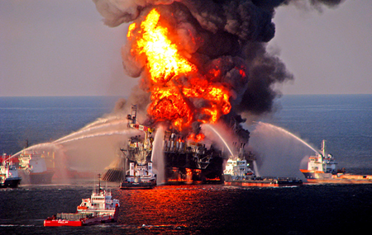
According to market analysts in the USA, the 2010 Deepwater Horizon disaster-the largest oil spill in history-likely registered as a net gain in GDP. Is this improving society?
Photo credit: https://latimesphoto.files.wordpress.com/2011/04/la-oil-spill-001.jpg

Slide 9
Alternatives to GDP
This PowerPoint will walk you through some of the alternate ways that development can be assessed. You will learn about:
GPI – Genuine Progress Indicator
HDI – Human Development Index
GNH – Gross National Happiness
HPI – Happy Planet Index
SSI – Sustainable Society Index
SPI – Social Progress Indicator

Slide 10
The Genuine Progress Index (GPI)
Also called the Index of Sustainable Welfare (ISEW)
GPI is calculated by adjusting GDP by subtracting social and environmental costs, and adding in the value of non-market productive activity, such as volunteer work and child rearing
Calculated by NGOs and think tanks :
Redefining Progress (GPI, 2006, U.S. only)
New economics foundation (MDP, 2004; UK only)
Friends of the Earth UK and New economics foundation (ISEW)

Slide 11
Calculating GPI
The calculation of GPI presented in the simplified form is the following:
GPI = A + B - C - D + I
A is income weighted private consumption
B is value of non-market services generating welfare
C is private defensive cost of natural deterioration
D is cost of deterioration of nature and natural resources
I is increase in capital stock and balance of international trade
The GPI indicator is based on the concept of sustainable income, presented by economist John Hicks (1948).
GPI depicts the state of welfare in the society by taking into account the ability to maintain welfare on at least the same level in the future.

Slide 12
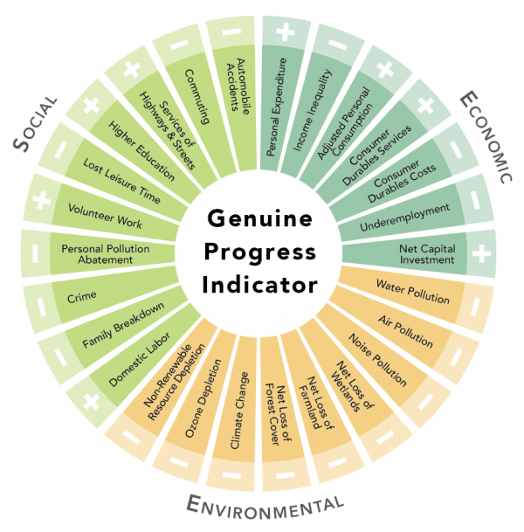
How GPI measures progress
The GPI starts with the same personal consumption data that the GDP is based on, but then makes some distinctions.
It adjusts for factors such as income distribution, adds factors such as the value of household and volunteer work, and subtracts factors such as the costs of crime and pollution. (+s or –s)
Because the GDP and the GPI are both measured in monetary terms, they can be compared on the same scale.
Image Source:http://www.donellameadows.org/genuine-talk-progress-and-the-gpi/

Slide 13
GPI and Alberta a Case Study
During the period of 1966-1999 various indicators were examined to compare the GDP and the GPI over that time period. While GDP has risen steadily since 1961, the GPI income line was stagnant through the 1960s and recovered after 1986 as the importance of oil and gas diminished and the value of unpaid work rose significantly.

Slide 14
GPI and Alberta a Case Study
1999 findings:
GDP = $37,005.04
GPI = $12,480.10
Why the big difference?
Value of unpaid time use + $38,830.19
Cost of Household/Personal Debt Servicing -$6,433.77
Social Costs -$23,405.73
Environmental Costs -$26,382.33
Some of the largest costs were from commuting, gambling, durability of consumer items, loss of wetlands, non-renewable resource use, Greenhouse gases and air pollution.
What does this tell us about Albertan Society? Is this valuable knowledge for people and/or governments? Explain.
Source: Anielski, M. (2001). MEASURING THE SUSTAINABILITY OF NATIONS: THE GENUINE PROGRESS INDICATOR SYSTEM OF SUSTAINABLE WELLBEING ACCOUNTS. The Fourth Biennial Conference of the Canadian Society for Ecological Economics: Ecological Sustainability of the Global Market Place, August 2001, Montreal, Quebec. http://www.anielski.com/Documents/Sustainability%20of%20Nations.pdf

Slide 15
Human Development Index (HDI)
The HDI was designed as a measure for progress in developing countries beyond simple income figures such as GDP.
The HDI was created to emphasize that people and their capabilities should be the ultimate criteria for assessing the development of a country, not economic growth alone.
A long and healthy life, knowledge and a decent standard of living are considered as the three key elements of development. Therefore, data on life expectancy, adult literacy, school enrolment and GDP are combined to calculate the index.

Slide 16
Human Development Index (HDI)
Starting with the 2010 Human Development Report the HDI combines three dimensions:
A long and healthy life: Life expectancy at birth
Education index: Mean years of schooling and Expected years of schooling
A decent standard of living: GNI per capita (PPP US$)

Slide 17
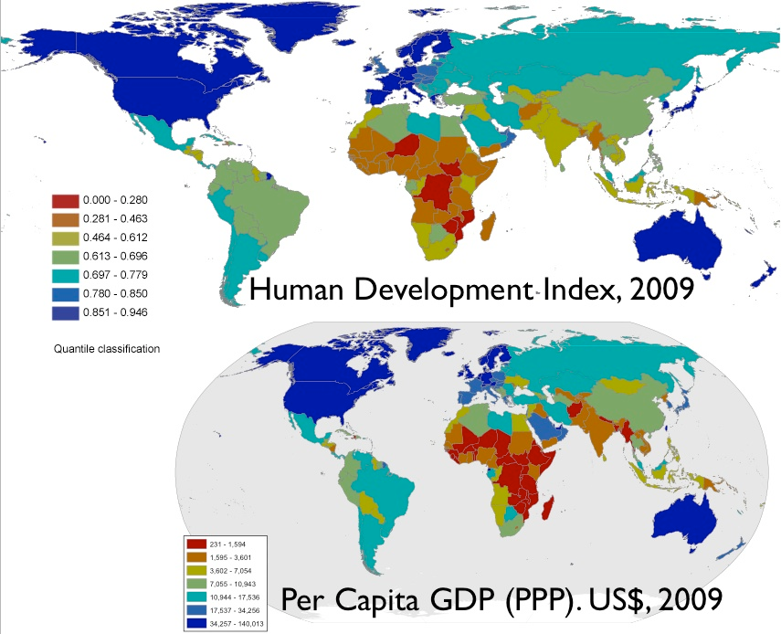
HDI around the Globe
World map indicating the category of Human Development Index by country compared to GDP
Source: http://geocurrents.info/wp-content/uploads/2011/08/HDIandGDPstate-based1.jpg

Slide 18
Gross National Happiness (GNH)
Developed in 1972 by Bhutan's fourth Dragon King, Jigme Singye Wangchuck
Every human being aspires for happiness therefore a country’s development would be measured in the happiness of the population.
The four pillars of GNH are:
A long and healthy life: Life expectancy at birth
Education index: Mean years of schooling and Expected years of schooling
A decent standard of living: GNI per capita (PPP US$)

Slide 19
Gross National Happiness (GNH)
First survey started in late 2007 in Bhutan. 950 people across Bhutan were asked 180 questions grouped into nine dimensions explained on the next slide.
Application: GNH is not a quantified measure. Rather, happiness is the guiding framework for the country’s five-year planning processes.
Video: Simple Show explains GNH

Slide 20
The survey in Bhutan
Lately, the four pillars have been further classified into nine domains in order to create widespread understanding of GNH and to reflect the holistic range of GNH values. The nine domains are:
Psychological well-being: Analyzed self-esteem, sense of competence, stress, spiritual activities, and the prevalence of positive and negative emotions.
Health: Measured the effectiveness of health policies, with criteria such as self-rated health, disability, patterns of risk behavior, exercise, sleep, nutrition, etc.

Slide 21
The survey con`t.
Use of time: One of the most significant factors in quality of life, especially time for recreation and socializing with family and friends. A balanced management of time was evaluated, including time spent in traffic jams, at work, in educational activities, etc.
Community vitality: Focused on relationships and interactions in communities. Examined the level of confidence, the sense of belonging, the vitality of affectionate relationships, safety at home and in the community, and the practice of giving and volunteering.
Education: Took into account several factors such as participation in formal and informal education, development of skills and capabilities, involvement in children's education, values education, environmental education, etc.

Slide 22
The survey con`t.
Culture: Evaluated local traditions, festivals, core values, participation in cultural events, opportunities to develop artistic skills, and discrimination due to religion, race or gender.
Environment: Measured the perception of citizens about the quality of their water, air, soil, forest cover, biodiversity, etc. The indicators included access to green areas, system of waste management, etc.
Governance: Assessed how the population views the government, the media, the judiciary, the electoral system, and the police, in terms of responsibility, honesty and transparency. It also measured involvement of citizens in community decisions and political processes.
Standard of living: Evaluated individual and family income, financial security, the level of debt, employment security, the quality of housing, etc.

Slide 23
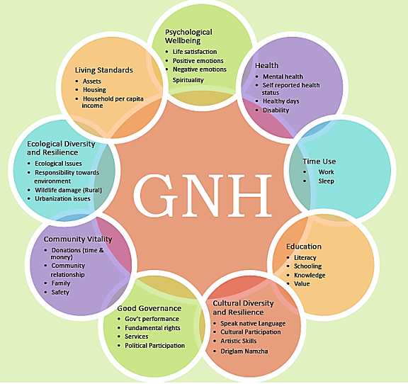
Source:http://www.eyes2bhutan.com/

Slide 24
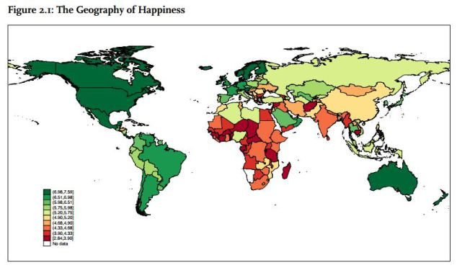
Map of Gross National Happiness
Source: usnews.com

Slide 25
Happy Planet Index (HPI)
Developed by the New Economics Foundation)
HPI = (Life satisfaction x Life expectancy)/Ecological Footprint.
Measure through Quality of life indices (generally):
Research on quality of life goes beyond economic and environmental statistics and includes surveys to get information directly from the individual.
Three key areas examined are life expectancy, ecological footprint and experienced well-being.
Nic Marks on The Happy Planet Index

Slide 26
Ecological footprint (EF)
EF measures the amount of natural resources an individual, a community, or a country consumes in a given year.
To understand the humanity’s footprint we need to know two key things:
Ecological Supply (the available biocapacity/ecological capacity)
Ecological Demand (our use of biological resources/the footprint).
Compares human consumption of natural resources with the planet’s ecological capacity to regenerate them
Assumes current technology levels, and looks at the amount of area needed to generate and to dispose of waste.

Slide 27
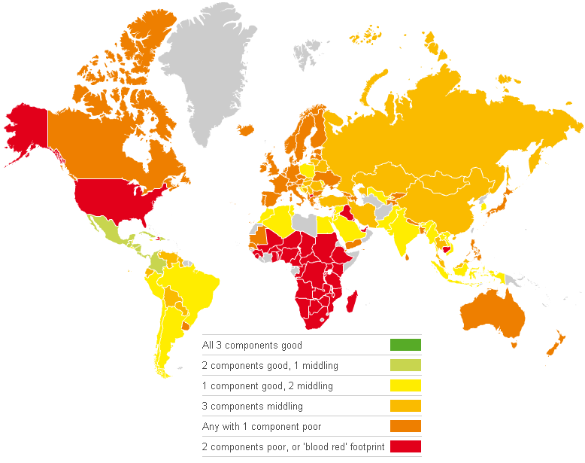
Happy Planet Index (2009)
Visit the interactive map:
http://chartsbin.com/view/b6h
Source:ChartsBin statistics collector team 2010, Happy Planet Index (HPI), ChartsBin.com, viewed 27th April, 2015, <http://chartsbin.com/view/b6h

Slide 28
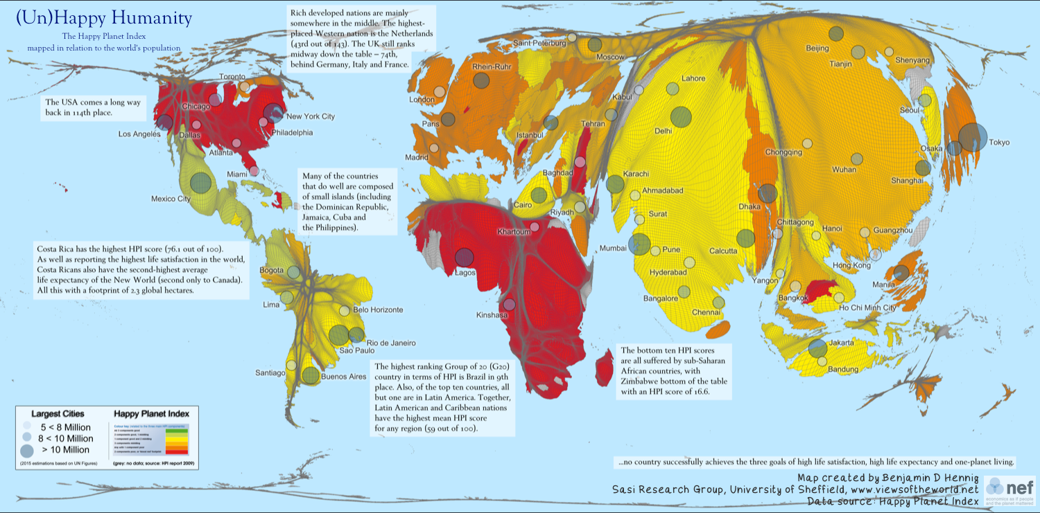
Source: http://www.happyplanetindex.org

Slide 29
Sustainable Society Index (SSI)
According to the SSI sustainability is about:
Us, human beings → Human Wellbeing (PEOPLE)
The environment, the ecosystem in which we live → Environmental Wellbeing (PLANET)
The economy, which enables us to do what we do → Economic Wellbeing (PROFIT)

Slide 30
Sustainable Society Index (SSI)
The three core values Human, Environment and Economic Wellbeing are not independent. On the contrary, they are very much interdependent. There are large trade-offs between all three values.
The SSI integrates Human Wellbeing and Environmental Wellbeing. Human Wellbeing without Environmental Wellbeing is a dead end, Environmental Wellbeing without Human Wellbeing makes no sense, at least not for human beings.
Economic Wellbeing is not a goal in itself. It is integrated as a condition to achieve Human and Environmental Wellbeing. It can be considered as a safeguard to wellbeing.
Let’s look at a global map and see how different countries fared:
http://www.ssfindex.com/ssi2014/maps/wellbeings/StatPlanet.html

Slide 31
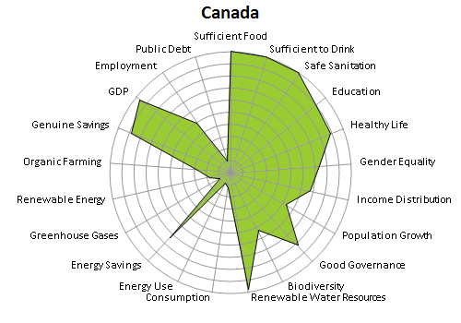
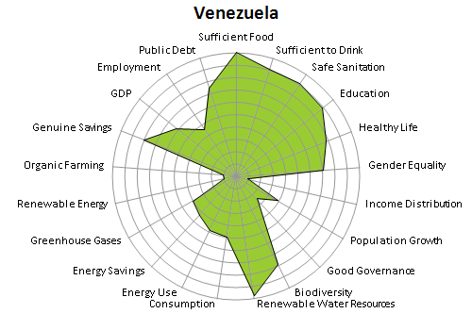
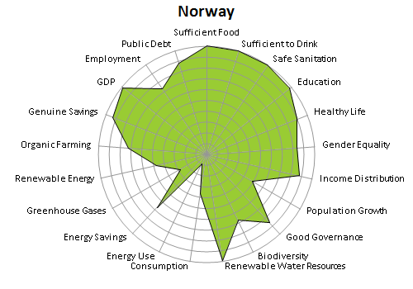
SSI Samples
Where are these countries successful?
Where do they need work?
Source: http://www.ssfindex.com/

Slide 32
Social Progress Index (SPI)
The Social Progress Index begins by defining what it means to be a good society based around three dimensions.
Basic needs for survival: food, water, shelter, safety?
Foundations of Well-Being: education, information, health and sustainable environment
Opportunity: rights, freedom of choice, freedom from discrimination and access to the world's most advanced knowledge

Slide 33
Social Progress Index (SPI)
Together, these 12 components form the Social Progress framework.
For each of these 12 components, indicators to measure how countries are performing. Not indicators of effort or intention, but real achievement. For example, SPI does not measure how much a country spends on healthcare, but the length and quality of people's lives.
Ted Talk Michael Green

Slide 34
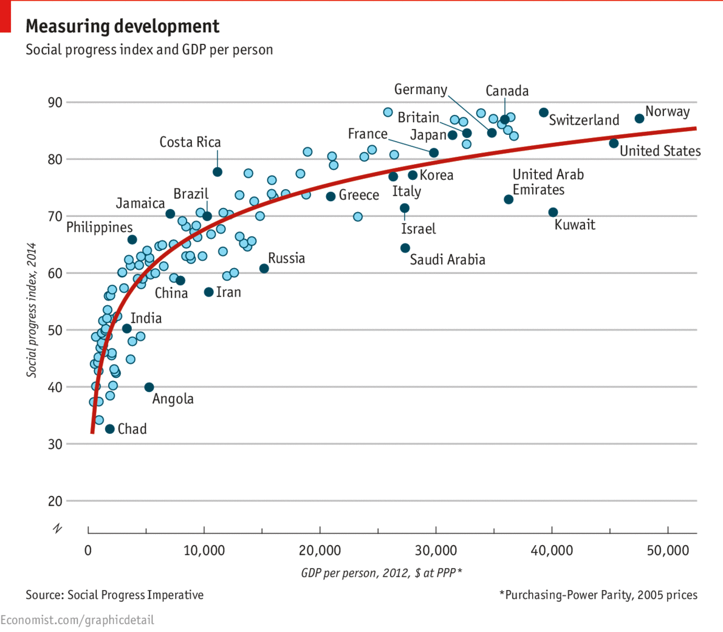
Source: http://progressivepress.com/pix/

Slide 35
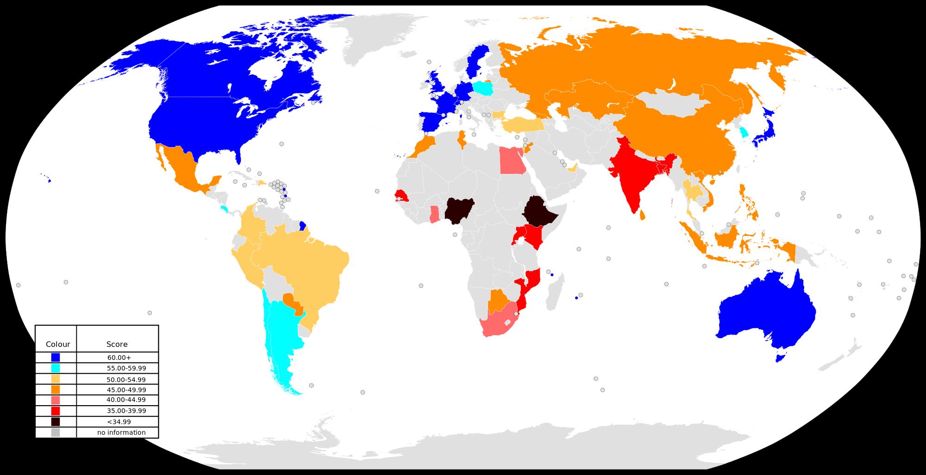
Map of SPI levels
Source: NuclearVacuum

Slide 36
Summary of Development Indicators
Development Indicator | Canada | Norway | Venezuela
GNH¹ | Ranking #6 Score: 7.477 | Ranking #2 Score: 7.655 | Ranking #20 Score: 7.039
HDI² | Ranking #8 Score: 0.902 | Ranking #1 Score: 0.944 | Ranking #67 Score: 0.764
HPI³ | Ranking #65 Score: 43.6 Well being=7.7 Life Expec.=81.0 Eco-foot.=6.4 | Ranking #29 Score: 51.4 Well being=7.6 Life Expec.=81.1 Eco-foot.=4.8 | Ranking #9 Score: 56.9 Well being=7.5 Life Expec.=74.4 Eco-foot.=3.0
SSI ⁴ Human Well-being Envir. Well-being Economic Well-being | Rank #13 Score 6.1 #23 #136 #65 | Rank #1 Score 7.0 #7 #99 #1 | Rank #120 Score 5.1 #102 #86 #53
SPI ⁵ | Ranking #6 Score: 86.89 | Ranking #1 Score: 88.36 | Ranking #72 Score: 63.45
GPI/ISEW | Recent Data Was Unavailable | Recent Data Was Unavailable | Recent Data Was Unavailable
Do any of the above results surprise you? Which one seems to be quite different?
Why do you think that this is this the case?

Slide 37
Summary: Problems with GDP
GDP ignores work that contributes directly to community health and happiness(volunteers, work at home).
GDP values work that decreases the overall well-being of society (i.e., environmental clean up, war, crime fighting)
GDP can grow even as poverty and inequality increase
More work hours make economy grow - free time has no value – affects health (stress)
Not an indicator that measures sustainability, but profit.

Slide 38
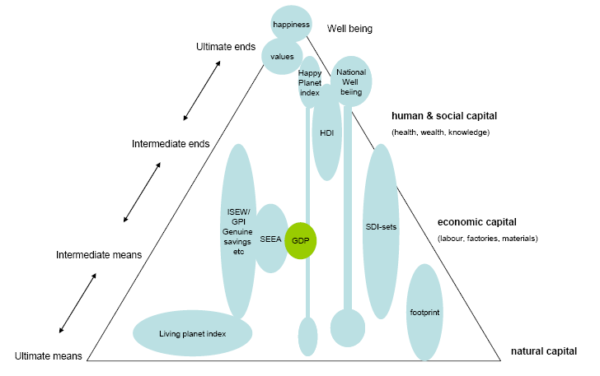
Different SDI approaches grouped around a policy cycle
(Source of policy cycle: de Ridder et al., 2006)

Slide 39
Questions for Reflection:
Values, elements of wellbeing
Consult the list you made at the start of class, how many items are valued by GDP? Does this indicator value your life?
Given this analysis, how effective is GDP as an overall indicator of progress and development?
Which indicator valued the objects you valued the most?
Reflect on what the world be like if we evaluated using each indicator. Evaluate the Pros and Cons of each indicator. Which do you feel is most and least effective? Explain your choices.
Why do you think the world is slow to adapt these indicators when evaluating development?

Slide 40
Questions for Reflection:
Values, elements of wellbeing
Some common considerations
(none having economic value)
Health
Family
Security
Knowledge
Community
Freedom
Ecological integrity
Equity

Slide 41
References:
UNSDSN (2014) World Happiness Report 2013. United Nations. Retrieved on July 11, 2015 from http://unsdsn.org/wp-content/uploads/2014/02/WorldHappinessReport2013_online.pdf
HDRO (2014). Human Development Report 2014 – Sustaining Human Progress: Reducing Vulnerabilities and Building Resilience. HDRO (Human Development Report Office), United Nations Development Programme. Retrieved 11 July 2015 from http://hdr.undp.org/en/content/table-1-human-development-index-and-its-components
Abdallah, S., Michaelson, J., Shah, S., Stoll, L. and Marks, N (2012) The Happy Planet Index: 2012 Report. New Economics Foundation http://www.happyplanetindex.org/
Neumayer, Eric (2004) Sustainability and well-being indicators. WIDER research papers, 2004/23. UNU-WIDER. ISBN 9789291906048. Retrieved on July 11, 2015 from http://www.napawatersheds.org/files/managed/Document/3470/VandeKerk2008%20AComprehensiveIndex4ASustainableSocietyTheSSI.pdf
Porter, M., Stern, S. and Green, M. (2014) SOCIAL PROGRESS INDEX 2015. Socil Progress Imperative. Retrieved July 11, 2015 from http://www.socialprogressimperative.org/data/spi

