Slide 1
Cradle to cradle
Design

Slide 2
Sustainable design
Watch the Ted Talk about Cradle to Cradle Design. It lasts approximately 19 minutes.
www.ted.com/talks/william_mcdonough_on_cradle_to_cradle_design
Questions
What are some unique features of Cradle to cradle design?
What are the three conditions for Human Artifice to be a living thing?
What is the difference between a biological and technical nutrient?
Why is it important to know where something comes from?
How is cradle to cradle design different than traditional design?

Slide 3
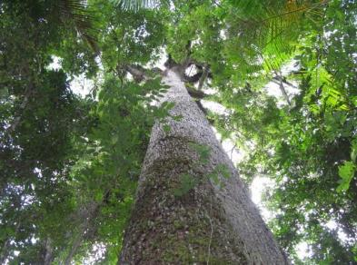
Cradle to cradle design–
Remaking the way we ake things
Written by William McDonough and Michael Braungart 2002
“If we try to solve the problems that plague us, our thinking must evolve beyond the level we were using when we created those problems in the first place” -Albert Einstein
What do you think Albert Einstein meant by this quote?
(Open World Foundation, 2012)

Slide 4
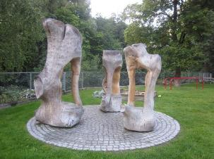
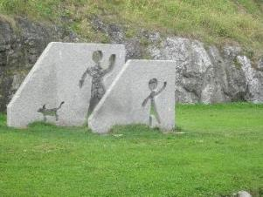
Cradle to cradle design–
Remaking the way we make things
How do we love all the children of all species for all time?
Our goal is a delightfully diverse, safe, healthy and just world, with clean air, water, soil and power – economically, equitably, ecologically and elegantly enjoyed

Slide 5
What is the most important change in thinking for Cradle to cradle design?

Slide 6
Step 1. Get “free” of known culprits (p. 166)
Begin by not using harmful substances especially substances that are known to bio-accumulate such as
Mercury
PVC
Cadmium
Lead

Slide 7
Making choices based on the best information available to you AND on their aesthetic judgement
Prefer Ecological Intelligence–by being “as sure as you can that a product or substance does not contain or support substances or practices that are blatantly harmful to the human and environmental health” p 171
Look for products that “can be taken back to the manufacturer and disassembled for reuse in technical production or at the very least returned to the industrial metabolism at a lower level–that is “down-cycled” p 171

Slide 8
Step 2. Follow informed Personal Preferences
Many real-life decisions come down to comparing two things that are both less than ideal
Prefer Ecological Intelligence
  Be as sure as you can that a product or substance does not contain or support substances that are blatantly harmful to human or environmental health. example is wood that comes from the Forest Stewardship Council seal of approval
Prefer Respect
  Respect for those who make the product, for the communities near where it is made, for those who handle and transport it, and ultimately for the customer
Prefer Delight, Celebration and Fun
“It’s very important that ecological intelligence products to be at the forefront of human expression. They can express the best of design creativity, adding pleasure and delight to life.” p.173

Slide 9
Step 3. Creating a “passive positive“ list
Research each product in greater depth looking at any problematic or potentially problematic characteristic property.
Are they toxic?
Are they carcinogenic?
How is the product used, and what is its end state?
What are the effects and possible effects on the local and global communities? p174
Products are put on one of the following lists…
  The X list
  The Gray list
  The P list
Can you guess which list is the WORST list?

Slide 10
THE X LIST
Can you remember the four culprits that were listed earlier?
Mercury
PVC
Cadmium and
Lead
Any substance that is teratogenic, mutagenic, carcinogenic, or otherwise harmful in direct and obvious ways to human and ecological life p. 174

Slide 11
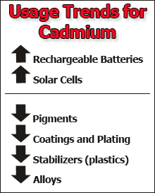
The Gray List
CADMIUM
Hazard Summary-Created in April 1992; Revised in January 2000 from the EPA United States Environmental Protection Agency…”
The main sources of cadmium in the air are the burning of fossil fuels such as coal or oil and the incineration of municipal waste. The acute (short-term) effects of cadmium in humans through inhalation exposure consist mainly of effects on the lung, such as pulmonary irritation. Chronic (long-term) inhalation or oral exposure to cadmium leads to a build-up of cadmium in the kidneys that can cause kidney disease.”
Contains problematic substances that are not quite so urgently in need of phase out or where there is currently no viable substitutes. p. 174.
http://www.epa.gov/air toxics/hlthef/cadmium.html
Image taken from https://www.osha.gov/SLTC/cadmium/

Slide 12
The “P List” or positive list
Substances that are ”actively defined as healthy and safe for use” p. 175
Based on
Acute oral or inhalative toxicity
Chronic toxicity
Whether the substance is a strong sensitizer
Whether the substance is a known or suspected carcinogen, mutagen, teratogen, or endocrine disrupter
Whether the substance is known or suspected to be a bio accumulative
Toxicity of water organisms (fish, daphnia, algae, bacteria) or soil organisms
Bbiodegradability
Potential for ozone-layer depletion
Whether all by-products meet the same criteria p. 175

Slide 13
Review: Terminology
Carcinogen
Tetragen
Mutagen
Endocrine Disrupter
Sensitizer
Bioaccumulative
Biodegradability
By-product

Slide 14
Step 4 Activate the positive list
Starting with the eco-effective principles design the product from beginning to end to become food for either biological or technical metabolisms.
A biological nutrient is a material or product that is designed to return to the biological cycle – it is literally consumed by microorganisms in the soil and by other animals. P. 105
A technical nutrient is a material or product that is designed to go back into the technical cycle, into the industrial metabolism from which it came. P. 110

Slide 15
Step 5-Reinvent
“ Design is based on the attempt to fulfill human needs in an evolving technical and cultural context. We begin by applying the active positive list to existing things, then to things that are only beginning to be imagined, or have not yet been conceived. When we optimize, we open our imaginations to radically new possibilities. We ask: What is the customer’s need, how is the culture evolving, and how can these purposes be met by appealing and different kinds of products or services.” p. 180

Slide 16
Explore: Cradle to cradle design challenge
“The goal of the Challenge is to eliminate the concept of 'waste' by designing products with materials that may be perpetually cycled to retain their value as nutrients to fuel growing global economies.”
Read more: www.dexigner.com/news/27869

