Slide 1
Oil Addiction
Who has it?
Who wants it?
Why should YOU care?

Slide 2
Which countries have the largest oil reserves?
One minute brainstorm:
Make your best ‘guestimation’ of the world’s top five oil rich countries.
Check out this world map:
click on the ‘Reserves & Capacity’ tab:
www.eia.gov/countries/index.cfm?view
Source: U.S. Energy Information Administration (2014)

Slide 3
World’s Biggest Proved Reserves
Country | 2014 Proved Reserves (billions of barrels)
Saudi Arabia, Venezuela | 200+
Canada, Iran, Iraq, Kuwait | 100 - 200
UAE, Russia | 50 - 100
Libya, Nigeria, Kazakhstan, United States, Qatar | 25 - 50
China, Algeria, Brazil, Mexico | 10 - 25
How many did you guess?
Source: U.S. Energy Information Administration (2014)

Slide 4
Which countries produce the most oil?
One minute brainstorm:
Make your best ‘guestimation’ of the world’s top five oil producing countries.
Check out this world map, click on the ‘Production’ tab:
www.eia.gov/countries/index.cfm?view
Source: U.S. Energy Information Administration (2012)

Slide 5
World’s Biggest Oil Producers
Country | 2014 Oil Production (millions of barrels per day)
1. Russia, Saudi Arabia, USA | 10+
2. China | 4 - 7
3. Brazil, Canada, Iran, Iraq, Kuwait, Mexico, Nigeria, Qatar, UAE, Venezuela | 2 - 4
4. Algeria, Angola, Kazakhstan, Libya, Norway, UK | 1 - 2
How many did you guess?
Source: U.S. Energy Information Administration (2014)

Slide 6
Which countries consume the most oil?
One minute brainstorm:
Make your best ‘guestimation’ of the world’s top five oil consuming countries.
Check out this world map, click on the ‘Consumption’ tab:
http://www.eia.gov/countries/index.cfm?view
Source: U.S. Energy Information Administration (2014)

Slide 7
World’s Biggest Oil Consumers
Country | 2014 Oil Consumption (millions of barrels per day)
1. USA | 10+
2. N/A | 7 - 10
3. Japan | 4 - 7
4. Canada, Germany, South Korea, Mexico | 2 - 4
5. Australia, France, Italy, Spain, UK | 1 - 2
How many did you guess?
Source: U.S. Energy Information Administration (2014)

Slide 8
Since country populations vary greatly, it is useful to look at per capita oil consumption.
Many statistics are expressed per capita, which means you divide the total by the country’s population:
Per capita oil consumption gives us an idea of approximately how much the average person consumes.
Country’s total oil consumption
Population of that country
Source: U.S. Energy Information Administration (2012)

Slide 9
Make your best guestimation.
Rank the following countries from highest (1) to lowest (10) per capita oil consumption:
1. China
2. USA
3. Canada
4. Australia
5. UK
6. Venezuela
7. Norway
8. Japan
9. Germany
10. New Zealand
Source: U.S. Energy Information Administration (2012)

Slide 10
Country | Oil consumption per capita (barrels/day per 1,000 people)
1. Canada | 64
2. USA | 61
3. Norway | 47
4. Australia | 44
5. Japan | 35
6. New Zealand | 35
7. Germany | 31
8. Venezuela | 27
9. UK | 26
10. China | 7
How many people got 10 out of 10 correct?
Source: Index Mundi (2012) http://www.indexmundi.com/map/?v=91000

Slide 11
Which activity consumes the most oil?
a. Driving
b. Putting on make-up
c. Eating fruits/vegetables
d. Heating houses

Slide 12
If you said driving you’re correct!
Transportation currently accounts for 23% of the world's greenhouse-gas emissions.
As of 2011 there were over 1 billion cars worldwide!
It’s predicted that there will be 2.5 billion cars worldwide by 2050.

Slide 13
Make your best guestimation
Rank the following countries from highest (1) to lowest (5) gas price:
1. Japan
2. USA
3. Canada
4. Norway
5. China
6. UK
7. Saudi Arabia
8. Venezuela
9. Mexico
10. New Zealand

Slide 14
Country | Gas price (litre, U.S. dollar) March 2015
1. Venezuela | $0.02
2. Saudi Arabia | $0.16
3. USA | $0.70
4. Canada | $0.93
5. Mexico | $0.95
6. China | $1.05
7. Japan | $1.14
8. New Zealand | $1.53
9. UK | $1.68
10. Norway | $1.94
How many people got 10 out of 10 correct?
Source: Global Petrol Priceshttp://www.globalpetrolprices.com (March 2015)

Slide 15
Compare gas prices (per gallon) around the world using this interactive map:
www.washingtonpost.com/wp-srv/special/world/gasoline-prices/

Slide 16
Think/Pair/Share
What is the relationship between gas prices and driving?
How does this relationship affect peoples’ lifestyles? Health?
How does this relationship affect the environment?
How does this relationship affect urban planning?

Slide 17
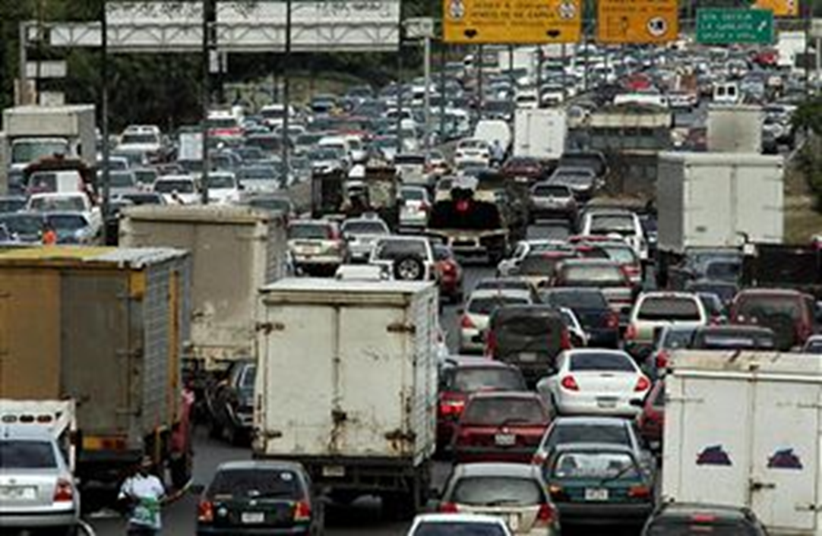
Venezuela
Source: Financial Times http://blogs.ft.com

Slide 18
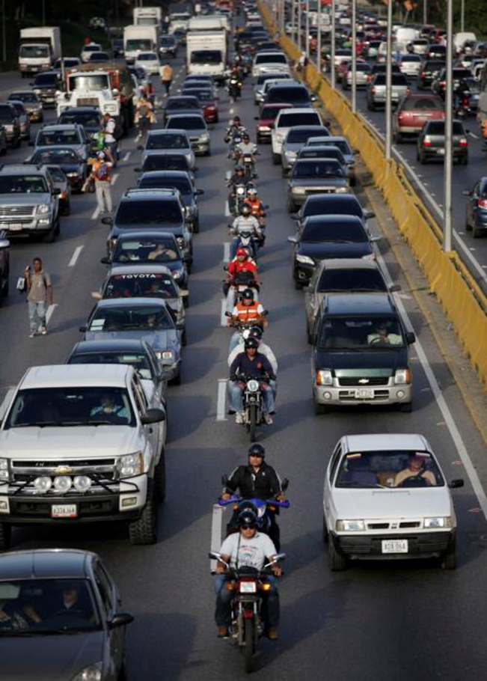
Venezuela
Source: Ariana Cubillos http://news.yahoo.com

Slide 19
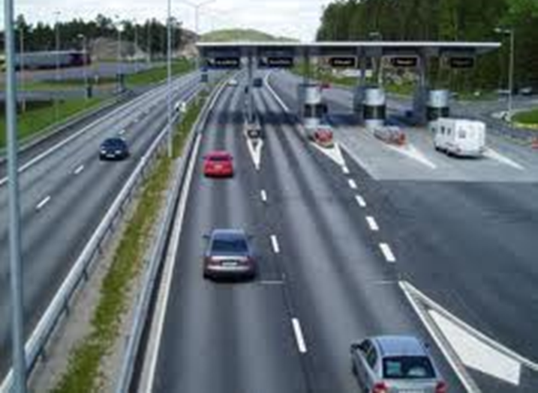
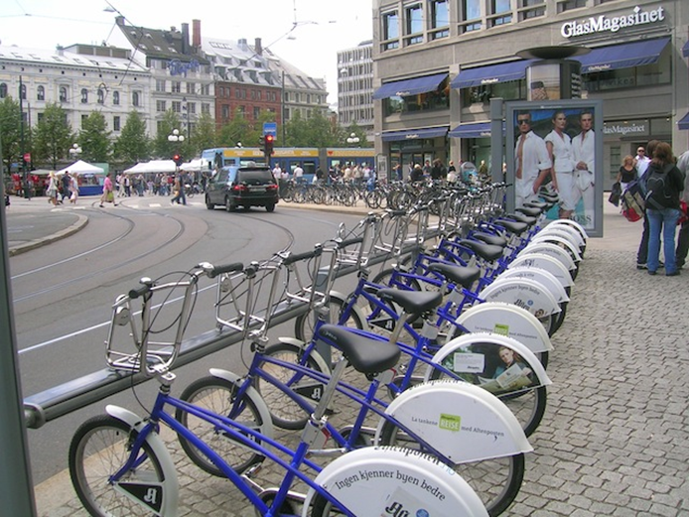
Norway
Source: http://www.m2mnow.biz
Source: http://vadebike.org

Slide 20
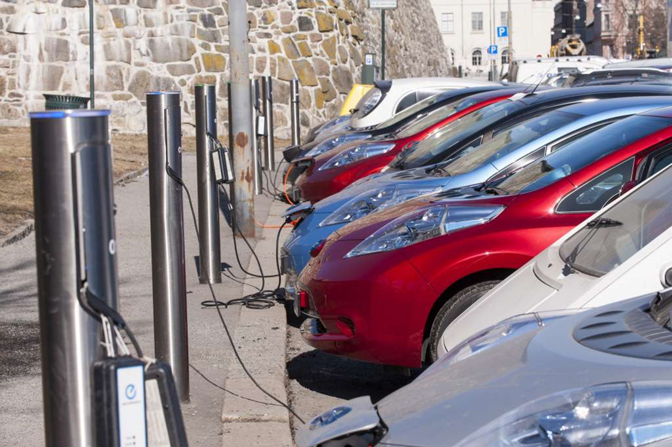
Norway
Source: Financial Times http://blogs.ft.com

Slide 21
Why should YOU care?
Oil is a non-renewable resource.
Eventually the world will run out of oil.
What will your life look like ‘after oil?’
How will the world be different ‘after oil?’

