Slide 1
How does your life depend upon
fossil energy?

Slide 2
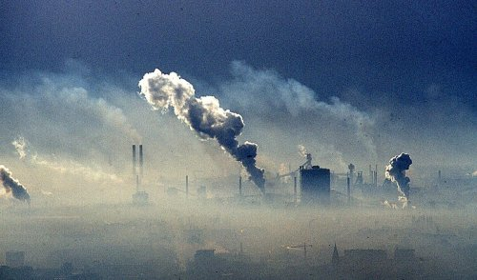

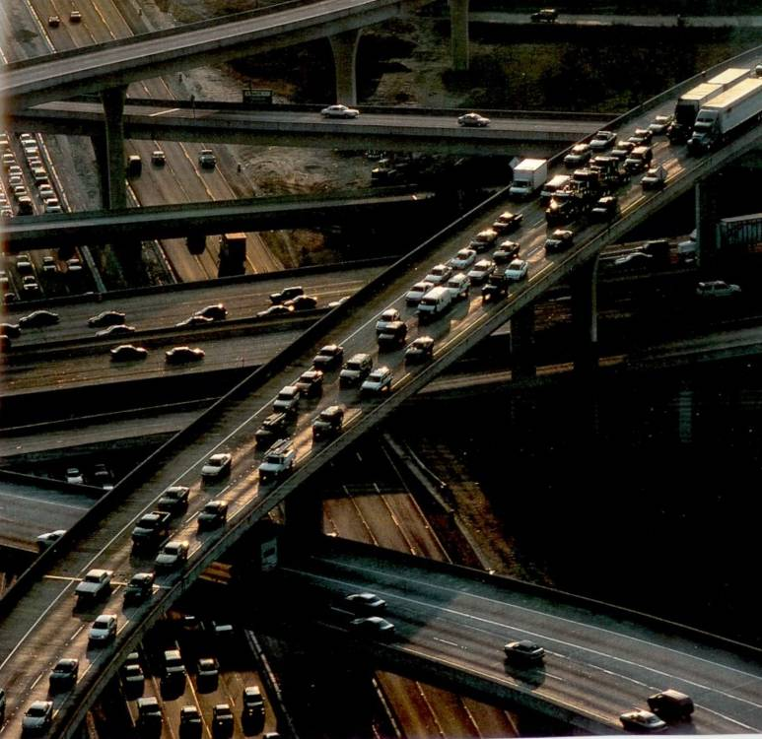
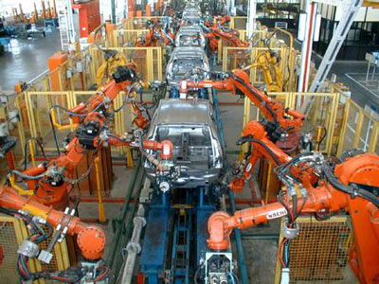

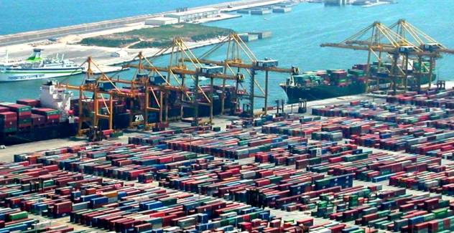

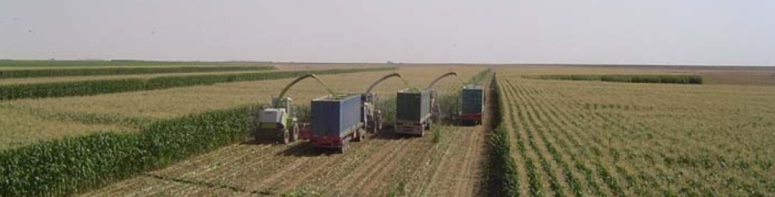
world’s Net Primary Energy supply: 80% fossil fuels

Slide 3
explosive industrial growth
rise of auto-based societies…
…& urban form
Industrialization of agriculture

Slide 4
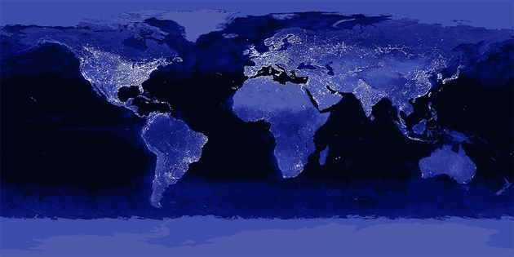
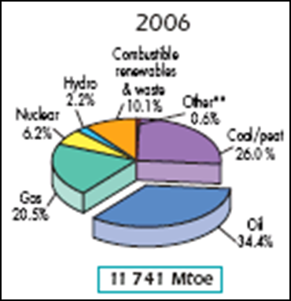
What is powering this picture?
81% fossil energy
‘lifeblood’ of industrial metabolism
1/3 Oil

Slide 5
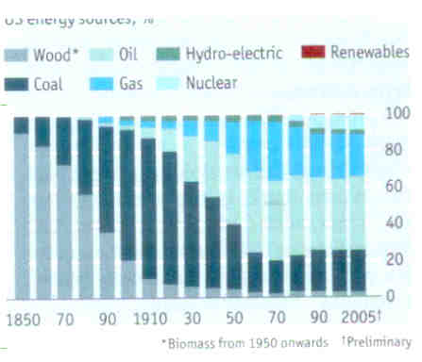
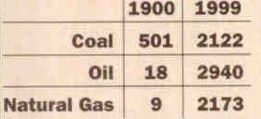
World Fossil Energy Consumption
US Energy Sources, 1850-2005
Million tons of oil equivalent

Slide 6
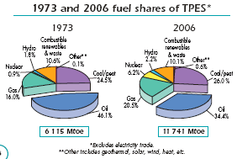
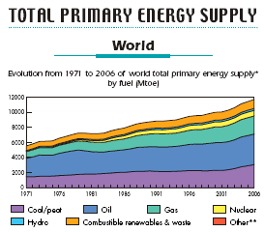
81%
87%
In 2006 (of this 81%):
  OIL ~34.4%
  COAL ~26%
  NAT’L GAS ~20.5%
Mtoe: megatonne of oil equivalent

Slide 7

(2010)
ANY PATTERNS?
 |  | Revenues ($ billions) | Profits ($ millions)
1 | Wal-Mart | 421.8 | 16.4
2 | Royal Dutch Shell | 378.2 | 20.1
3 | Exxon-Mobil | 354.7 | 30.5
4 | BP | 308.9 | -3.7
5 | Sinopec | 273.4 | 7.6
6 | China National Petroleum | 240.2 | 14.4
7 | State Grid Corp. of China | 226.3 | 4.6
8 | Toyota | 221.8 | 4.8
9 | Japan Post | 204.0 | 4.9
10 | Chevron | 196.3 | 19.0
11 | Total | 186.1 | 14.0
12 | ConocoPhillips | 185.0 | 11.4
13 | Volkswagon | 168.0 | 9.1

Slide 8
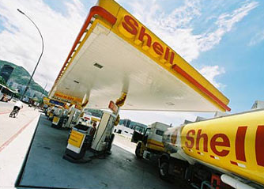
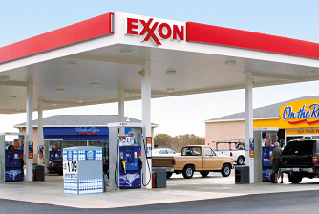
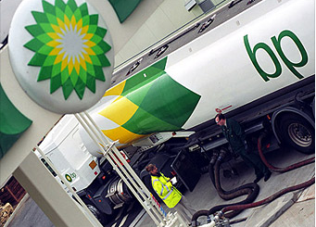
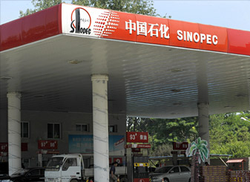
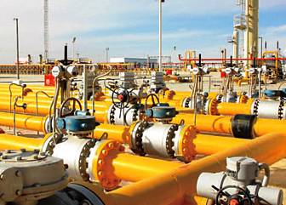
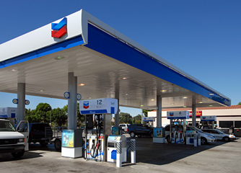
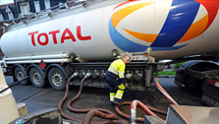

ANY PATTERNS?
1 Wal-Mart
2 Royal Dutch Shell
3 Exxon-Mobil
4 BP
5 Sinopec
6 China National Petroleum
7 State Grid Corp. of China
8 Toyota
9 Japan Post
10 Chevron
11 Total
12 ConocoPhillips
13 Volkswagon
OIL INDUSTRY: most profitable industry based on return on revenues

Slide 9
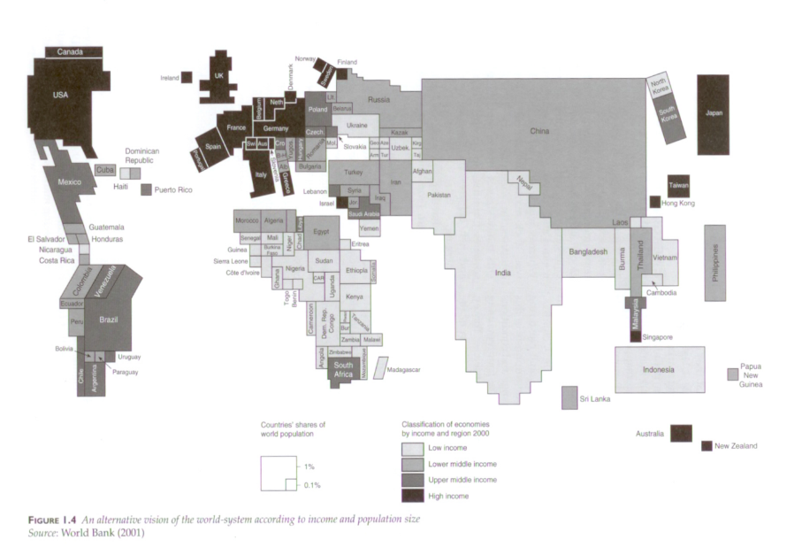
Fossil Energy: The 'lifeblood' of the global economy
4/5 world’s net primary energy supply
- very uneven prod'n & consumption
- natural gas and coal: point source generation
- oil: virtually all transportation fuel
Sized by population

Slide 10
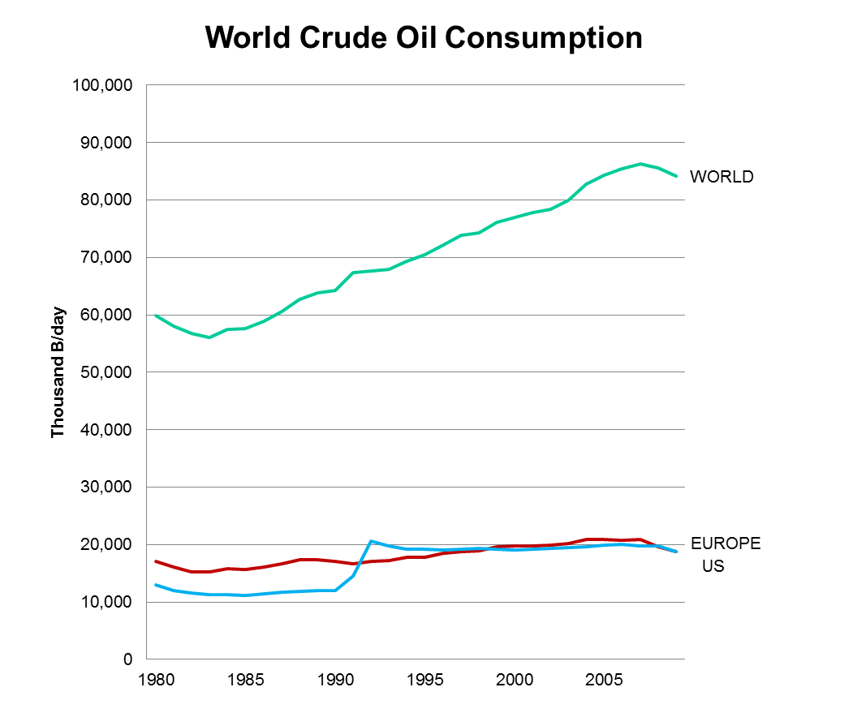
US
+
Europe
~50%
US
+
Europe
~50%
2nd Gulf War

Slide 11

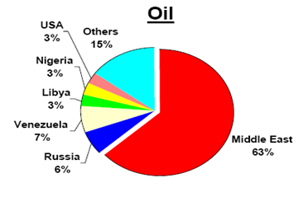
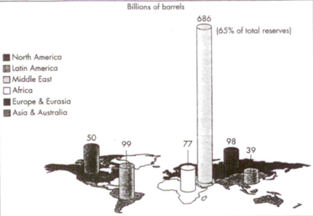
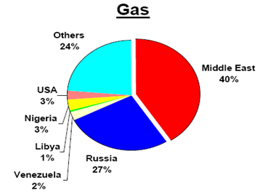
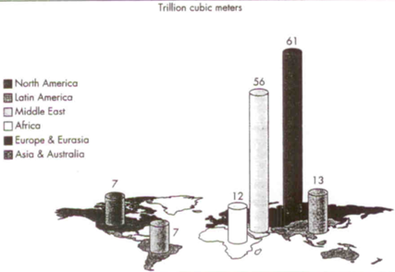
Convention oil & gas reserves (in early 2000s)

Slide 12
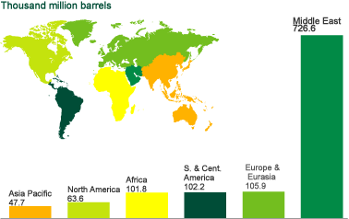
Convention oil & gas reserves (in early 2000s)
CONVENTIONAL OIL & NAT’L GAS COMBINED – BP est.s

Slide 13

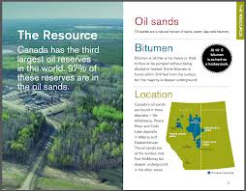
BUT also, very recently…

Slide 14
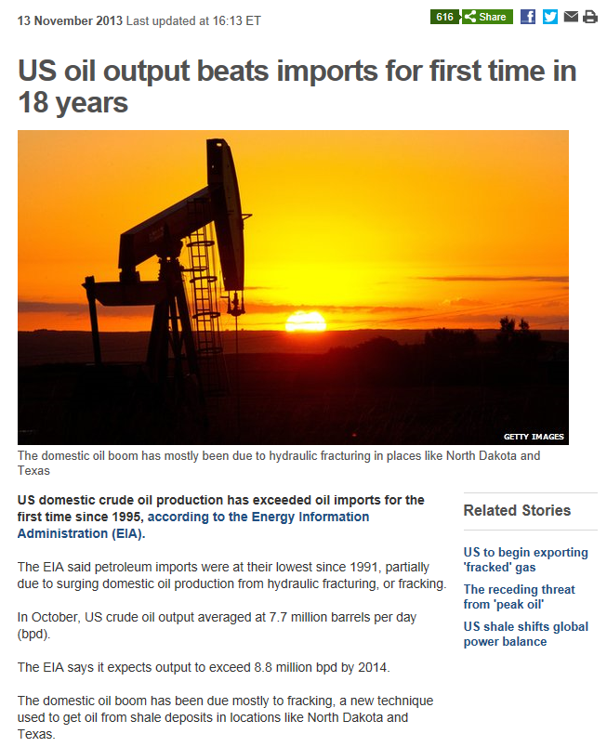
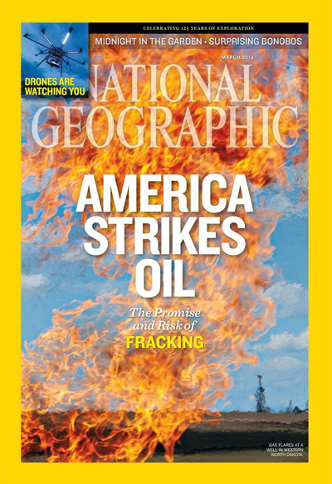

Slide 15

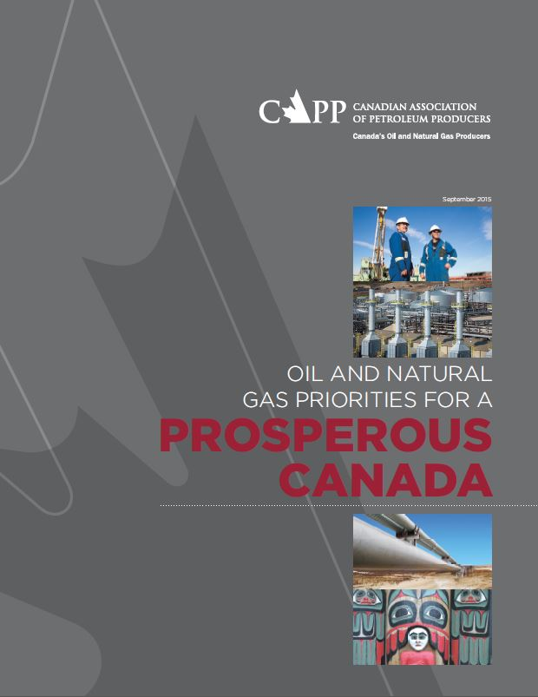
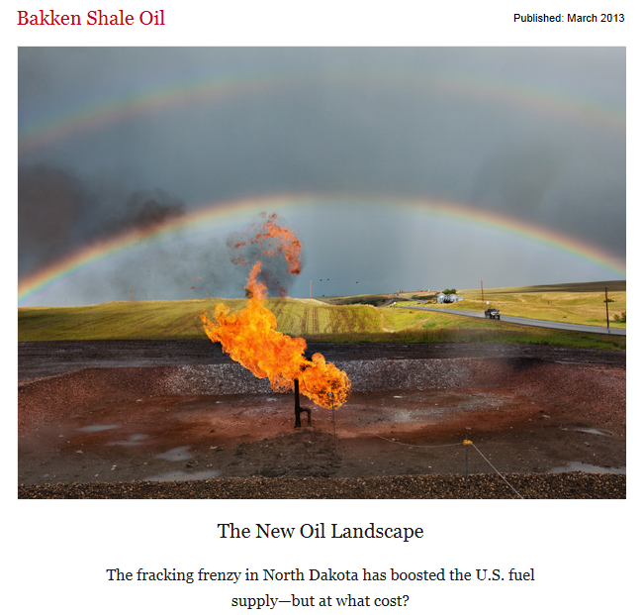
http://ngm.nationalgeographic.com/2013/03/bakken-shale-oil/dobb-text

Slide 16
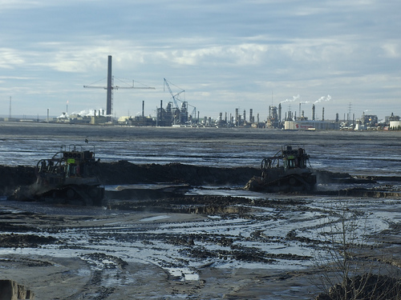
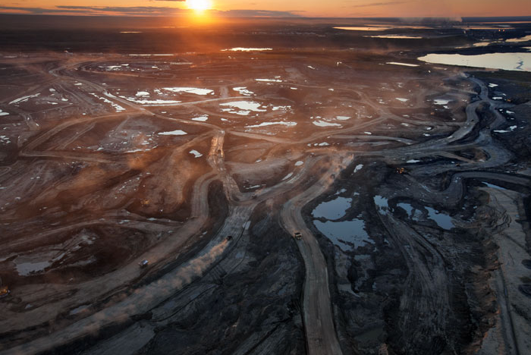
The Oil Sands in Alberta
Extraction 1: surface mining
‘ripping away the Boreal to get to the oil’ (Rees)
‘the biggest open pit mining project in the world’ (Burtynsky)

