Slide 1
Oil Sands

Slide 2
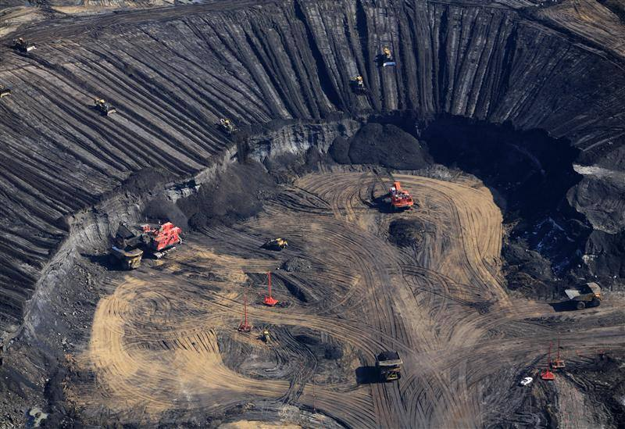
Alberta sits over one of the largest recoverable oil patches in the world, second only to Saudi Arabia.

Slide 3
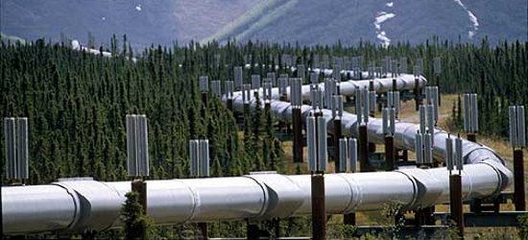
Canada has become the largest supplier of oil to the U.S., with more than a million barrels per day coming from the oil sands.

Slide 4
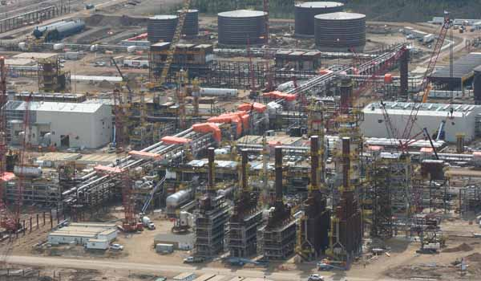
Currently 40 per cent of all oil produced in Canada is derived from the oil sands.

Slide 5
Oil sands are different than conventional oil.
- Take a lot of energy to extract the oil
- Use a lot of water
- Leave a very large environmental footprint

Slide 6
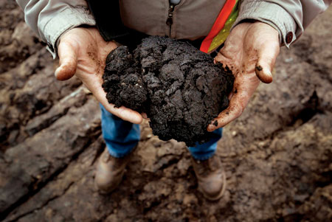
The oil sands also…
- provide employment
- spur local economic growth
- reduce our reliance on foreign owned oil

Slide 7
As a class, we will be dividing into five groups.
Each group will represent a stakeholder in the Albertan Oil Sands.
We will be holding a Town Hall Meeting.
The purpose of Town Hall Meetings is to provide a space for community members to share their perspective on a topic of concern. In this format, different perspectives are often shared.

Slide 8
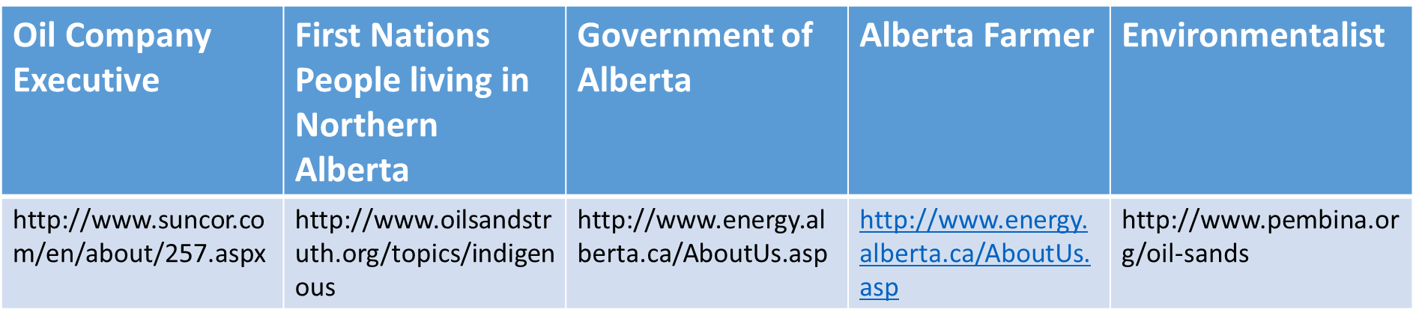
Some stakeholders include:

Slide 9
Step 1: Divide into five groups.

Slide 10
Step 2: Read/ Research in your ‘Expert Groups’
Discuss the reading among your group.
What are the main ideas and facts presented?
Students appoint one person in their group to summarize their reading to the class.

Slide 11
Step 3: “Town Hall” discussion
Part 1: Summaries
Arrange chairs in a circle, providing one chair per group.
The person assigned to summarize for each group sits in the chair. The other students then form a larger standing circle around the chairs.
Each representative summarizes the reading assigned to the group. Just the facts.

Slide 12
Step 4: “Town Hall” discussion
Part 2: Comments and questions
After all readings have been summarized, students seated in the circle can comment on what they have heard or to ask one of their peers a question.
Students in the outer circle are then allowed to enter the conversation by "tapping" the shoulder of someone in their own group and taking their seat.

Slide 13
Step 5: Debrief
After the discussion, students will reflect on the following questions in their journals and/or through a class discussion:

Slide 14
What did you learn from this activity?
How did your ideas about the topic change during this activity, if at all? Explain what caused your ideas to change or why you think your ideas did not change at all.
What does perspective mean? Where does our perspective come from? How does our perspective shape how we see the world?

