Slide 1
Professional Advisory
Addressing Hate and Discrimination:
Facilitator’s PowerPoint

Slide 2
Purpose:
These slides support facilitators of professional learning to build awareness of:
College Professional Advisories,
the new Professional Advisory Addressing Hate and Discrimination, and/or
the Case Studies that accompany the Professional Advisory on Addressing Hate and Discrimination.

Slide 3
Sample use cases:
Back-to-school staff communication
Professional learning session
Staff meeting
AQ course
Teacher education course
Leadership development session
Collaborative inquiry

Slide 4










Professional Advisories
The College’s advice to all Ontario Certified Teachers (OCTs)
Visit the College website (oct.ca) to access the Professional Advisories
Consider how advisories work together to support consistent, informed professional practice
Review the new Professional Advisory Addressing Hate and Discrimination
Notes:
Facilitation suggestion:
Highlight to participants that each professional advisory is a self-contained, “quick read” guidance document. However, to support consistent and informed professional practice, OCTs should consider reading advisories together as the topics are interconnected.

Slide 5
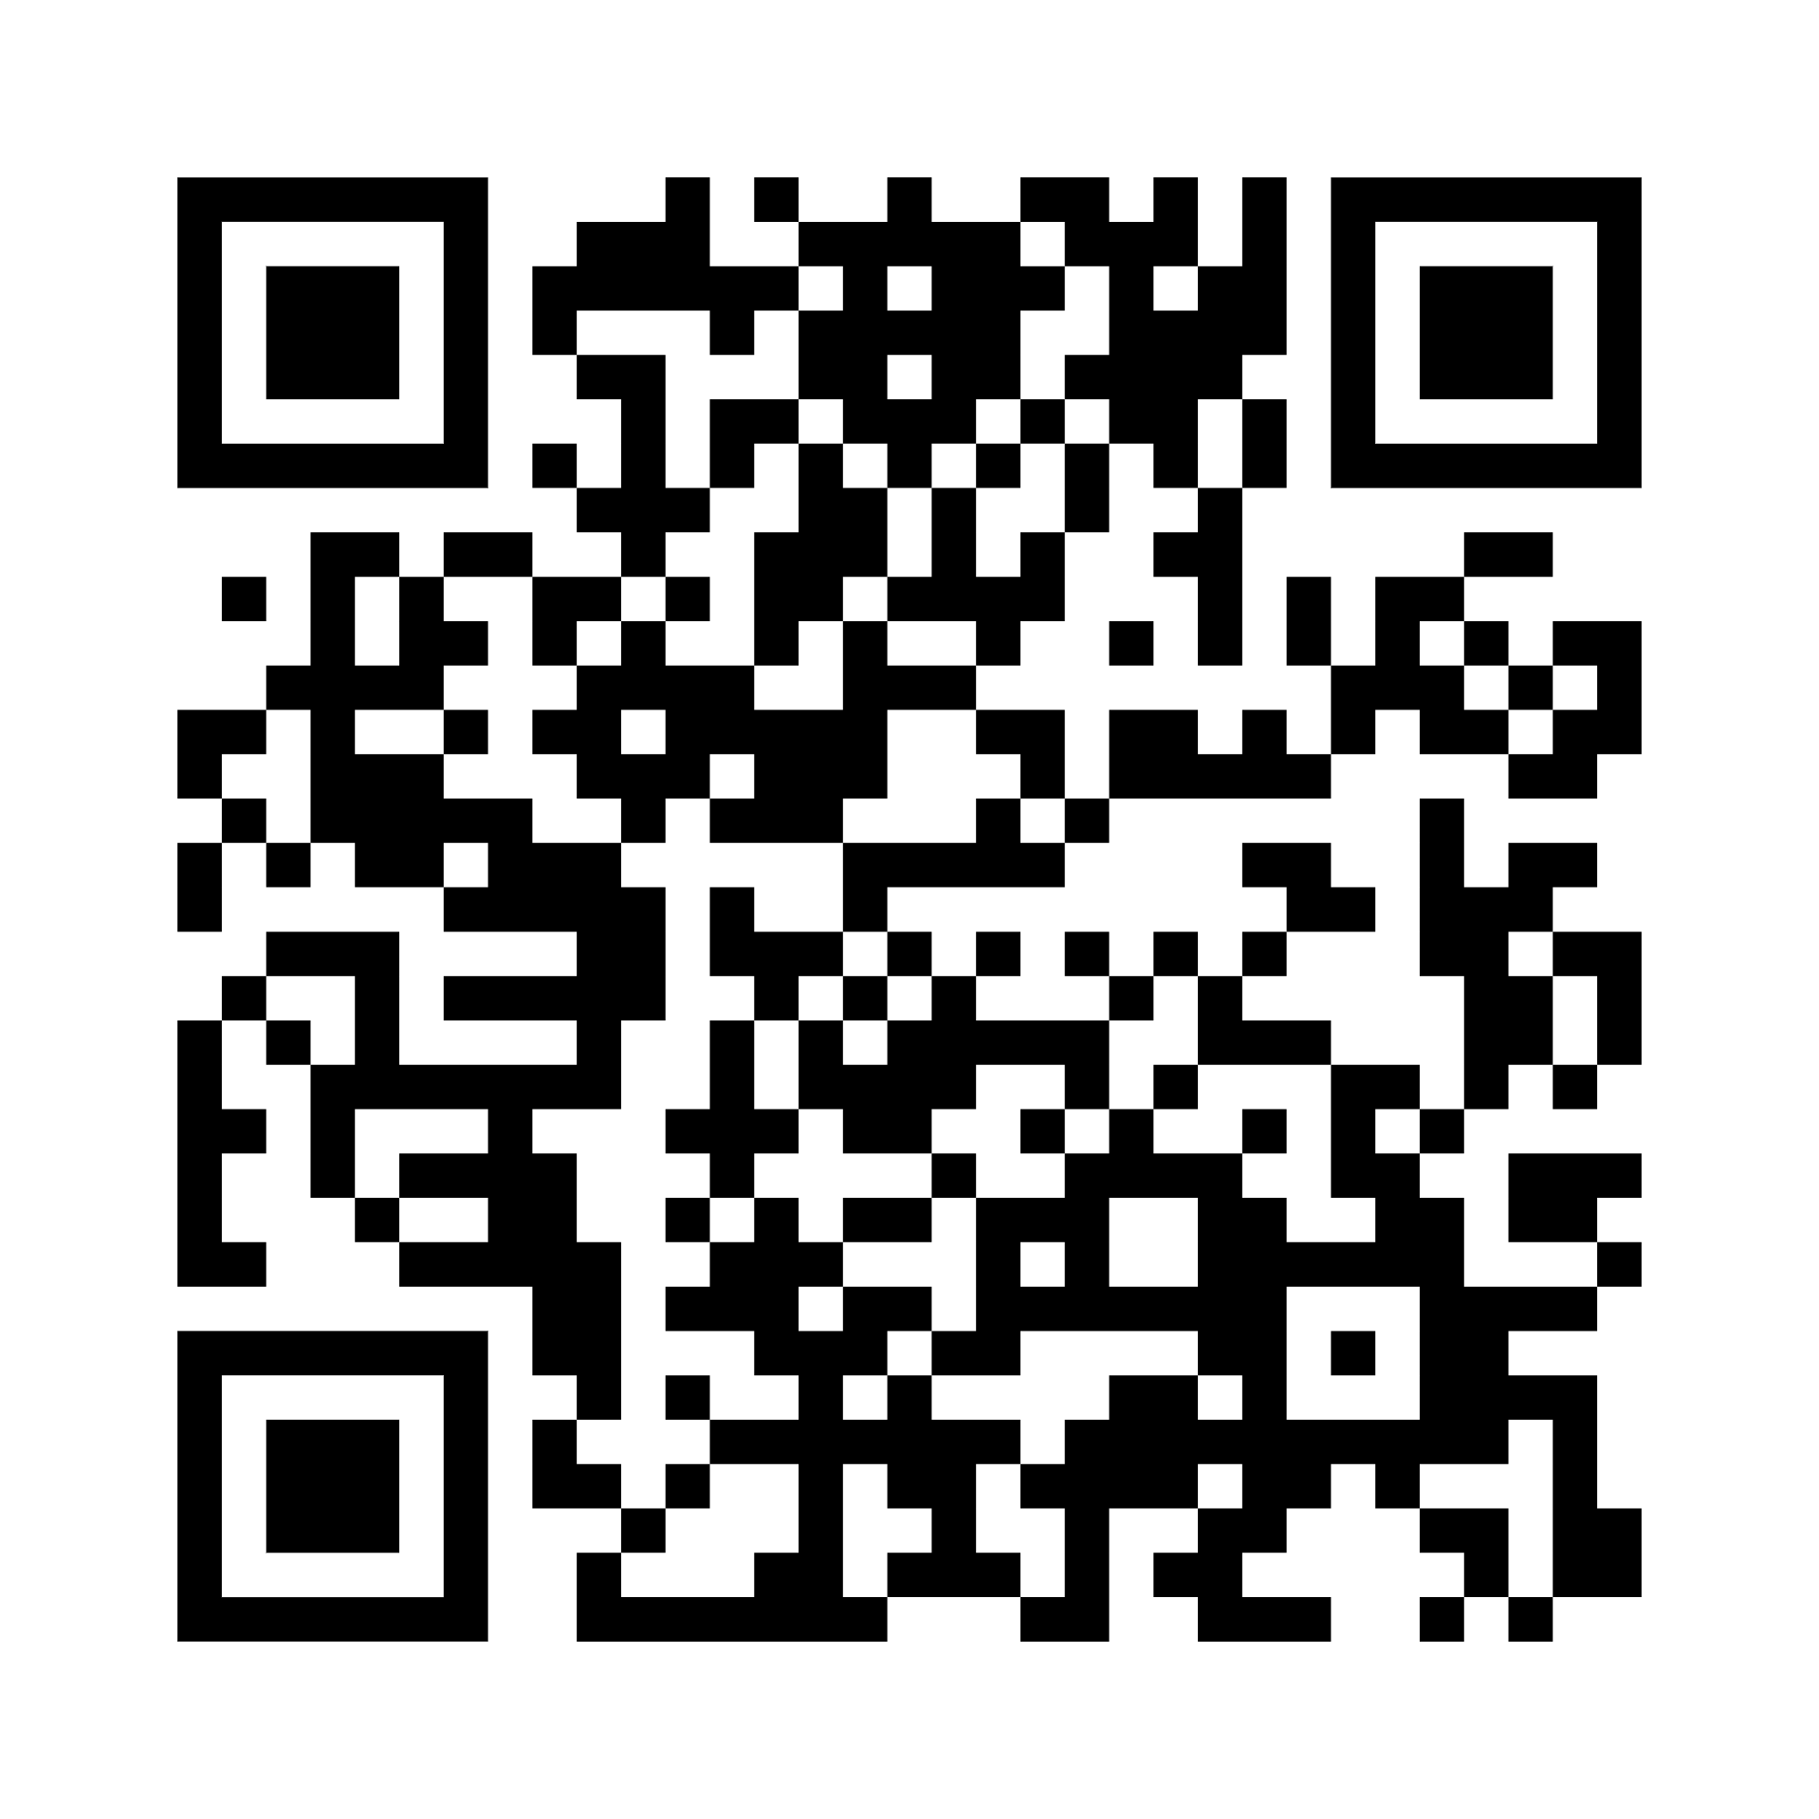
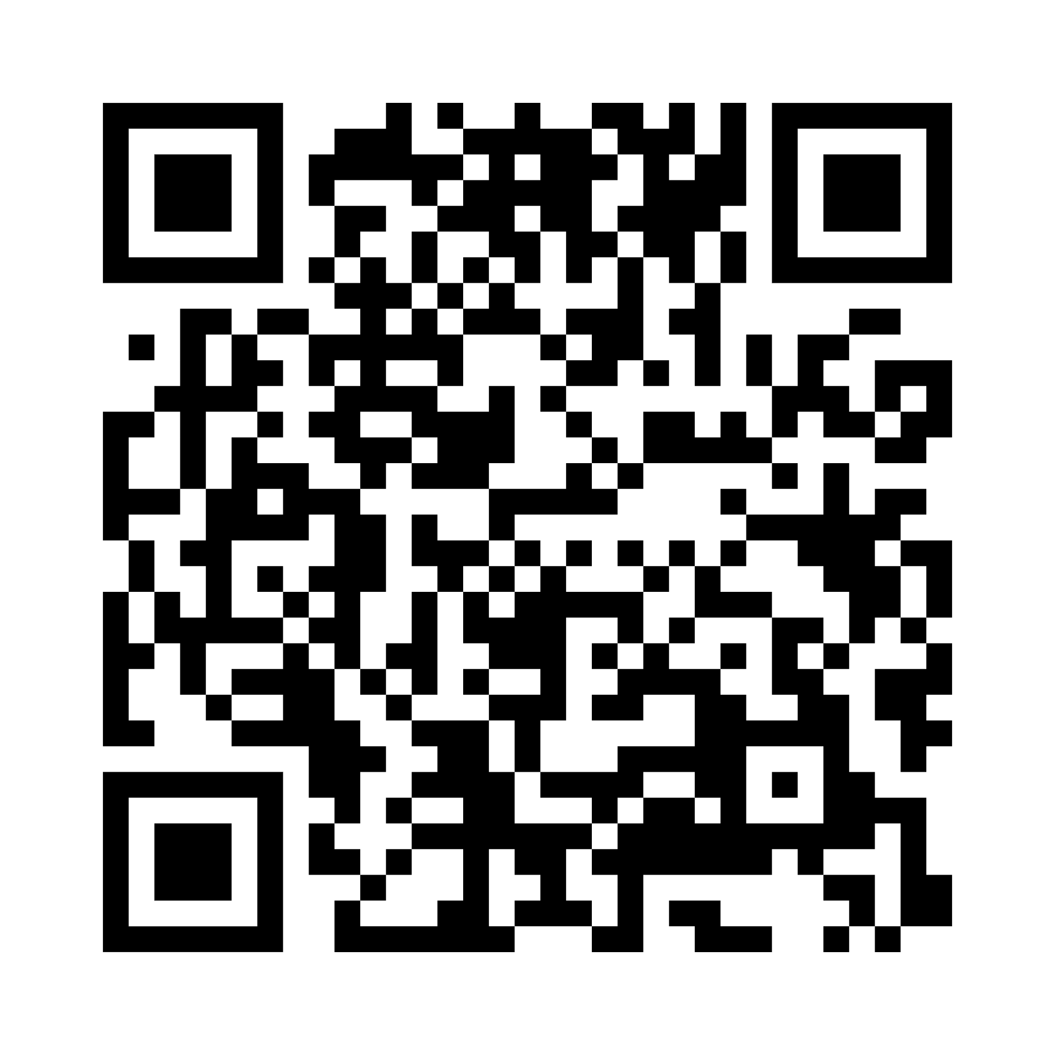
New guidance for OCTs
Professional Advisory Addressing Hate and Discrimination
Helps OCTs recognize and address incidents of hate and discrimination within learning environments.
Highlights legal, ethical and professional responsibilities.
Explore the advisory at oct-oeeo.ca/PA_addressing_hate_and_discrimination
oct-oeeo.ca/PA_2025_PDF
oct-oeeo.ca/PA_2025_AUDIO
Notes:
Facilitation suggestion:
Invite participants to scan the QR code for direct access to the professional advisory in pdf and audio formats. Participants can also click on the hyperlink for the text version of the advisory.

Slide 6
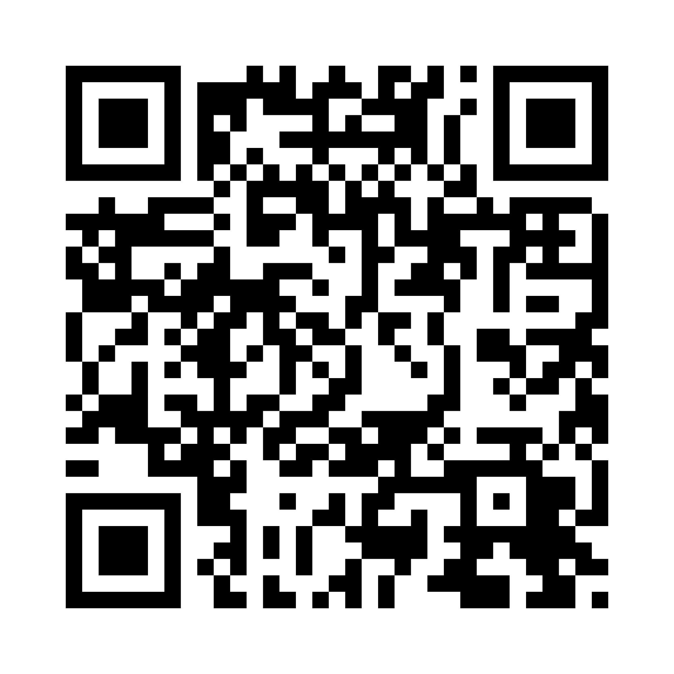
Case studies based on real life occurrences
Addressing Hate and Discrimination
Review the case studies (oct-oeeo.ca/casestudies) to reflect on how to address and respond professionally to acts of hate and discrimination.
Topics include:
  Freedom of expression
  Political and personal beliefs
  Culturally inappropriate resources
  Diverging from curriculum
  Harmful jokes
  Discrimination against students with exceptionalities

Slide 7

Discussion prompts:
Sample case studies based on real life occurrences

Slide 8
What would you do in this situation?
Case Study 1: Based on real life occurrences
A fellow OCT says: “I feel it is wrong to teach my Grade 8 students about gender identity, gender expression and sexual orientation as indicated in the health and physical education curriculum. As an OCT, I can decide what is appropriate to teach to my students.” Select all that apply.
  Ignore – it’s their opinion
  Help them to understand the importance of creating safe and inclusive spaces for all students
  Notify your supervisor or follow board protocols
  Seek additional support (e.g., union, equity lead)
Explore these nine scenarios (oct-oeeo.ca/casestudies) for practical guidance to address acts of hate and discrimination.
Notes:
A facilitator of professional learning may select this slide to pique interest of participants (e.g., as a Minds On activity), before introducing scenarios/case studies.

Slide 9
What would you do in this situation?
Case Study 2: Based on real life occurrences
A fellow OCT says: “My racialized colleague teaches art. I told them their talents are wasted and that they should, instead, be teaching math because their culture is known for excelling in math. My colleague seemed upset by my comment.” Select all that apply.
  Ignore – it’s their opinion
  Help them to understand how this is a racial microaggression
  Notify your supervisor or follow board protocols
  Seek additional support (e.g., union, equity lead)
Explore these nine scenarios (oct-oeeo.ca/casestudies) for practical guidance to address acts of hate and discrimination.
Notes:
A facilitator of professional learning may select this slide to pique interest of participants (e.g., as a Minds On activity), before introducing scenarios/case studies.

Slide 10
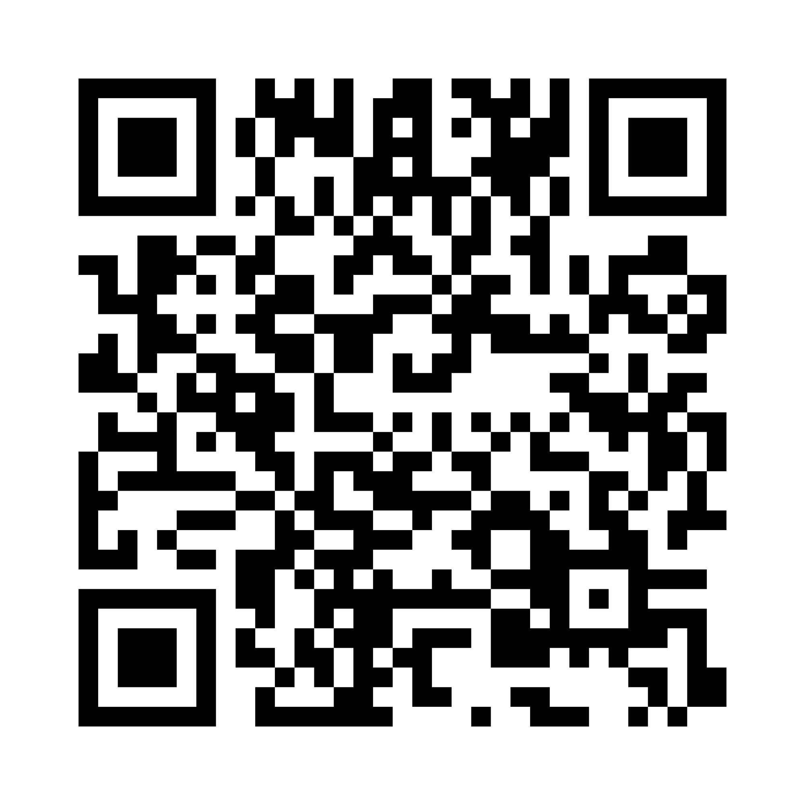
Help us improve future offerings
Please take 2 minutes to share your thoughts on the supplementary resources to the Professional Advisory Addressing Hate and Discrimination. Your feedback will help guide the development of future materials that are relevant, practical, and supportive to OCTs.
Share Your Feedback
oct-oeeo.ca/PAsurvey

Slide 11
End Slide Dark Blue
Notes:
End of Presentation Slide
Bilingual logo in dark blue

